Slide 1
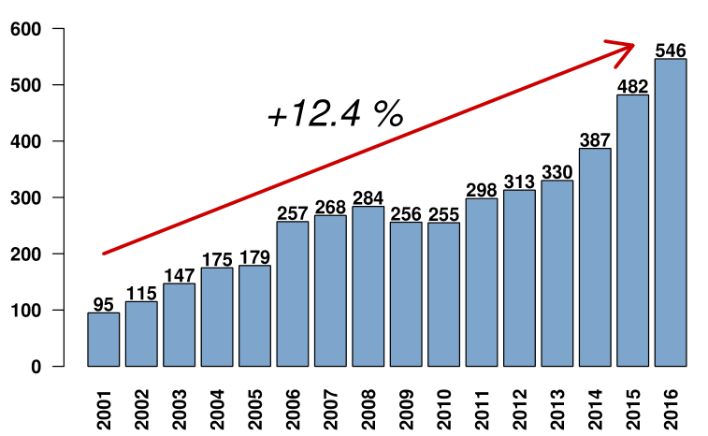
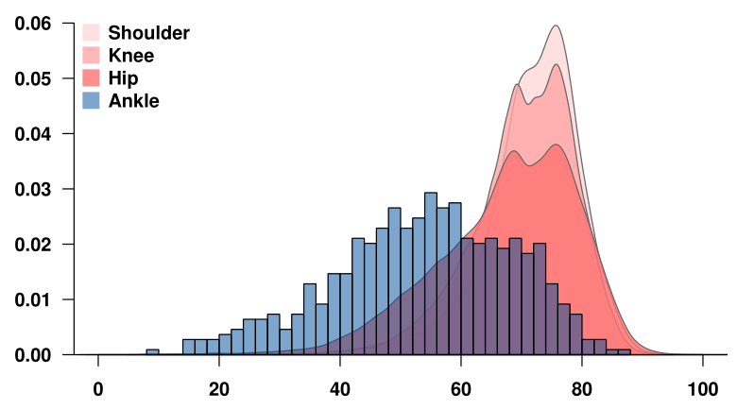
8th International Congress of Arthroplasty Registries
Leiden, The Netherland, June 1-3, 2018
Italian Arthroplasty Registry: introducing ankle data collection
Torre M¹, Carrani E¹, Luzi I², Sampaolo L², Laricchiuta P¹, Galati F³, Ceccarelli S¹, Masciocchi M¹, Ciminello E^{1,4}, Boniforti F⁵, Zanoli G⁶, Alfieri Montrasio U⁷, Giannini S⁸.
¹ Scientific Presidency Secretariat, Italian National Institute of Health, Rome, Italy; ² National Centre for Disease prevention and health promotion, Italian National Institute of Health, Rome, Italy; ³ DG-IT Service, Italian National Institute of Health, Rome, Italy; ⁴ La Sapienza University of Rome, Rome, Italy; ⁵ Fondazione San Raffaele Giglio, Cefalù (PA), Italy; ⁶ Casa di Cura Santa Maria Maddalena, Occhiobello (RO), Italy; ⁷ IRCCS Istituto Ortopedico Galeazzi, Milano (MI), Italy; ⁸ Istituto Ortopedico Rizzoli, Bologna (BO), Italy
INTRODUCTION
The Italian Arthroplasty Registry (RIAP), which is arranged as a regional registries federation, collects hip, knee (since 2013) and shoulder (since 2017) arthroplasty data. Currently, the data collection is voluntary and based on Hospital Discharge Data (HDD) supplemented with a “Minimum Data Set” (MDS) of additional variables. The process followed in order to include in RIAP’s framework the ankle data collection is presented here.
MATERIALS AND METHODS
Firstly, 2001-2016 HDD were browsed (ICD-9 81.56) to analyze temporal trends, hospital volumes and geographical distribution of total ankle replacements in Italy. Then, different registries’ data forms (from Norway, UK, Australia) were compared to draw a draft list of variables that were evaluated by a committee of orthopaedic surgeons. They successively selected the variables to be adopted as MDS.
RESULTS
Analysis of data, based on HDDs (2001-2016):
the procedures increased +12.4%/year (fig.A);
in 2016, two regions out of 21 performed 69.6% of the national volume and only three medical facilities performed more than 50% of the overall;
in 2016, the average age of patients suffering a replacement of ankle was considerably lower than the one of patients having hip, knee or shoulder replacement. In addition, there was a higher variability of the distribution (fig. B).
List of MDS selected variables: joint, side, type of procedure, additional procedures performed simultaneously, primary and revision diagnosis, previous procedure on the same joint, approach, fixation, bone graft, catalogue numbers of the implanted devices.
Figure A: Trend of total volume of ankle replacement in years.
DISCUSSION/CONCLUSION
The ankle procedures data collection started January 2019. Thanks to the RIAP web platform, the MDS collection (fig. C) is assured. The HDD and MDS data linkage is performed locally.
In 2018, RIAP was included in the National Registry of implantable devices, established by law on 3/3/2017. The development of regulations to make data collection mandatory in all the regions is still ongoing. Their adoption will provide a high level of completeness throughout the country.
Figure B: Comparison of age of patients who suffered a joint replacement by joint.
Acknowledgements
The Italian Arthroplasty Registry is funded by the Directorate General of Medical Devices and Pharmaceutical Service of the Italian Ministry of Health
For any further information please contact: riap@iss.it
Figure C: Italian Arthroplasty Registry – RaDaR web app for data collection (homepage).

