Slide 1




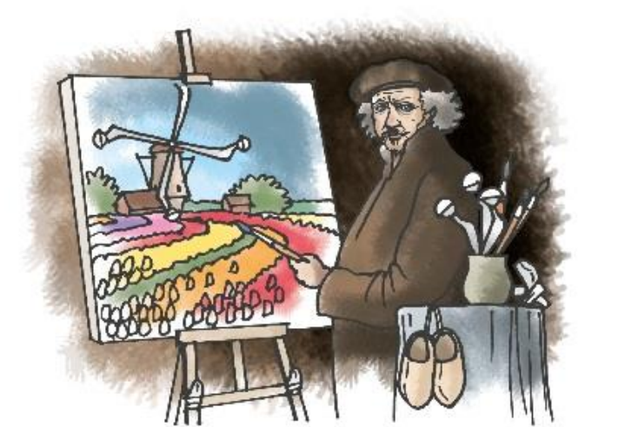
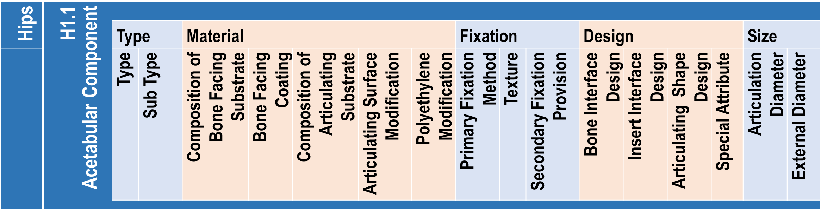

8th International Congress of Arthroplasty Registries
Leiden, the Netherlands, June 1-3, 2019
A new collaboration on the horizon:
the National Joint Registry (NJR) and the Italian Arthroplasty Registry (RIAP) towards an agreement
upon a common component database and device classification systems harmonisation
Torre M¹, Franzò M^{1,3}, Carrani E¹, Sampaolo L², Marinozzi F³, Bini F³, Stella E⁴, Caton E⁵, Swanson M⁵, Tucker K⁶, Armstrong R⁵, Young E⁷
¹ National Centre for clinical excellence, healthcare quality and safety, Italian national Institute of Health, Rome (Italy)
² National Centre for disease prevention and health promotion, Italian national Institute of Health, Rome (Italy)
³ Department of Mechanical engineering, La Sapienza University of Rome, Rome (Italy)
⁴ General Directorate of medical devices and pharmaceutical service, Italian Ministry of Health, Rome (Italy)
⁵ Northgate Public Services, London (United Kingdom)
⁶ ODEP, Beyond Compliance, London (United Kingdom)
⁷ National Joint Registry for England, Wales, Northern Ireland and the Isle of Man, London (United Kingdom)
INTRODUCTION
Medical device classification systems are essential to run market surveillance and vigilance activities. They allow to organize medical devices in homogeneous categories of products intended to perform a similar diagnostic or therapeutic intervention.
The 2007 Italian Ministry of Health (MoH) Decree established the "National Classification of Medical Devices" (CND). Then, the Italian Arthroplasty Registry (RIAP) set up the RIAP-DM-Dictionary and classified devices using the CND. The latest available version of CND classification is available for consultation on the Italian Ministry of Health website at http://www.salute.gov.it/.
The National Joint Registry (NJR) collects information on all hip, knee, ankle, elbow and shoulder replacements. NJR Component database is based on a detailed device classification. It combines information to identify the implanted device and a description of its technical characteristics, thus allowing comparison of different prostheses performance.
The aim of this study is to describe the first steps taken towards the harmonisation of CND and NJR classifications in the framework of the future collaboration between NJR and RIAP, to create a shared international database of the orthopaedic prostheses.
CND terminals
NJR combinations
Hip prosthesis | acetabular components | acetabular cups | Cemented metal acetabular cups - primary surgery |  | Acetabular component: cemented modular metal (composition)
 |  |  | Cemented polyethylene acetabular cups - primary surgery |  | Acetabular component: cemented modular polyethylene
 |  |  | Uncemented metal acetabular cups - primary surgery |  | Acetabular component: cementless modular metal (composition)
 |  |  | Uncemented monobloc polyetylene acetabular cups - primary surgery |  | Acetabular component: cementless monobloc polyethylene
 |  |  | Uncemented monobloc metal acetabular cups - primary surgery |  | Acetabular component: cementless monobloc metal (composition)
 |  |  | Cemented acetabular - revision surgery |  | Acetabular component: revision specific cemented
 |  |  | Uncemented acetabular cups - revision surgery |  | Acetabular component: revision specific cementless
 |  |  | Hip resurfacing acetabular cups |  | Acetabular component: surface replacement cup
 |  | acetabular insert | polyetylene acetabular insert |  | Acetabular insert (type undefined): polyethylene
 |  |  | ceramic acetabular insert |  | Acetabular insert (type undefined): ceramic
 |  |  | metal acetabular insert |  | Acetabular insert (type undefined): metal (composition)
 |  | dual mobility | Cemented dual mobility acetabular cups |  | Acetabular component: dual mobility cemented
 |  |  | Uncemented dual mobility acetabular cups |  | Acetabular component: dual mobility cementless
 |  |  | Dual mobility acetabular insert |  | Acetabular insert: dual mobility
 |  | preassembled | Preassembled acetabular cup with ceramic acetabular insert |  | Acetabular component: preassembled ceramic
 |  |  | Preassembled acetabular cup with polyetylene acetabular insert |  | Acetabular component: preassembled polyethylene
 | femoral components | femoral stems | Nonmodular straight cemented femoral stems- primary surgery |  | Modular head stem (standard): cemented straight
 |  |  | Nonmodular anatomic cemented femoral stems - primary surgery |  | Modular head stem (standard): cemented anatomical
 |  |  | Modular cemented femoral stems - primary surgery |  | Femoral stem with modular neck: cemented
 |  |  | Cemented femoral stems conservative - primary surgery |  | Methaphyseal (short stem) prosthesis: cemented
 |  |  | Nonmodular straight uncemented femoral stems - primary surgery |  | Modular head stem (standard): cementless straight
 |  |  | Nonmodular anatomic uncemented femoral stems - primary surgery |  | Modular head stem (standard): cementless anatomical
 |  |  | Modular uncemented femoral stems - primary surgery |  | Femoral stem with modular neck: cementless
 |  |  | Uncemented femoral stems conservative - primary surgery |  | Methaphyseal (short stem) prosthesis: cementless
 |  |  | Hip resurfacing femoral components |  | Resurfacing head
 |  |  | Cemented femoral stems - revision surgery |  | Femoral component: revision specific cemented
 |  |  | Uncemented femoral stems - revision surgery |  | Femoral component: revision specific cementless
 |  |  | Femoral stems for complex cases |  | Tumour prosthesis
 |  | femoral heads | Ceramic femoral heads- partial hip replacement |  | Modular head: ceramic
 |  |  | Metal femoral heads- partial hip replacement |  | Modular head: metal (composition)
 |  |  | Ceramic femoral heads- total hip replacement |  | Modular head: ceramic
 |  |  | Metal femoral heads- total hip replacement |  | Modular head: metal (composition)
 |  |  | Hip prosthesis- biarticular cups |  | Bipolar head (monobloc or modular)
 |  |  | Onepiece prosthesis- hip hemireplacement |  | Femoral component: monobloc
METHODS
CND is organized in 21 anatomical/functional categories, each one identified by a letter. Category P includes Implantable prosthetic devices. It is organized in groups and sub-groups up to 7 levels according to specific technical characteristics (fig. 1).
Category P:
«Implantable prosthetic devices and osteosynthesis devices»
Group P09:
«orthopaedic prostheses, osteosynthesis devices, devices for tendons and ligaments synthesis»
Sub-group P0908: «hip prosthesis»
Levels characteristics:
Anatomic component
Type
Fixation method (cemented or cementless)
Material (metal, ceramic or polyethylene)
Figure 1: CND structure for hip prostheses
NJR classification system is a flat/non-hierarchical structure. NJR taxonomy is dynamic and provides each anatomical joint with several attributes (anatomic component, type, material, fixation method, design, size) (fig. 2).
The advantages of this architecture: it is comprehensive and flexible, it supports validation through incorporation of business rules, upload of data by industry is easy. Moreover, it supports ease and speed of computational analysis of the underlying database.
Figure 2: NJR structure for acetabular component
Both CND and NJR taxonomies were matched and compared for hip joint components to associate to each CND terminal level a similar description obtained combinating attributes in the NJR taxonomy.
RESULTS
A combination of attributes in the NJR taxonomy was found for each CND terminal levels (tab. 1).
CONCLUSION
The harmonization of different classification systems is the first step towards the organization of an international component database since their comparability enables the integration of devices from different databases.
On 4th March 2019, the EU Commission adopted CND nomenclature as a base to support the activity of the future European database of medical devices EUDAMED. In this frame, the results achieved through this study are even more interesting.
Table 1. Hip joint components: CND terminal level vs NJR attributes combination
The Italian Arthroplasty Registry is funded by the Directorate General of Medical Devices and Pharmaceutical Service of the Italian Ministry of Health
The National Joint Registry (NJR) for England, Wales, Northern Ireland and the Isle of Man was set up by the Department of Health (DH) and Welsh Government in 2002

